Slide 1
Seminar project: ai coding tools

Slide 2
Group c
1959019 - Phạm Lê Hoàng Minh
2159001 - Võ Quang Dũng
2159011 - Nguyễn Ngọc Phú

Slide 3

What is an AI Coding Tool?

Slide 4
Definition
AI coding tools are software applications that leverage artificial intelligence to assist developers in writing, debugging, and optimizing code.
These tools use machine learning algorithms to understand code patterns and provide suggestions.

Slide 5
Examples
GitHub Copilot: Provides real-time code suggestions and autocompletions.
Tabnine: An AI code generator that helps improve coding accuracy and efficiency.
DeepCode: Uses AI to analyze code and provide suggestions for bug fixes and improvements.
Kite: Offers code completions and documentation in real-time to help with Python programming.
Replit: An AI-powered software development platform that offers code completion and personalized assistance based on the project's codebase.

Slide 6
Benefits of Using AI Coding Tools

Slide 7
Increased Productivity: AI coding tools can significantly speed up the coding process by providing real-time suggestions and automating repetitive tasks.
Improved Code Quality: These tools help in detecting bugs early and suggesting best practices, leading to cleaner and more reliable code.
Learning Assistance: AI tools can serve as educational aids, helping developers learn new coding techniques and improve their skills.
Collaboration: Enhanced team collaboration through shared coding standards and real-time code review suggestions.

Slide 8


Slide 9

How to Project Management
This project lasts 8 weeks, broken into 4 sprints, each lasting 2 weeks. Each team member gets 20 hours every sprint to perform their tasks.

Slide 10
Nguyễn Ngọc Phú – 80h | Võ Quang Dũng – 80h | Phạm Lê Hoàng Minh – 80h
Editing video – 40h | Research – 22h | Scriptwriting – 26h
Screen Recording Setup – 14h | Outline Creation – 20h | Narration Script – 20h
Demo Preparation – 16h | Visual Assets Collection – 30h | Quality Assurance – 10h
Final Editing – 10h | Demo Preparation – 8h | Final Review – 14h

Slide 11


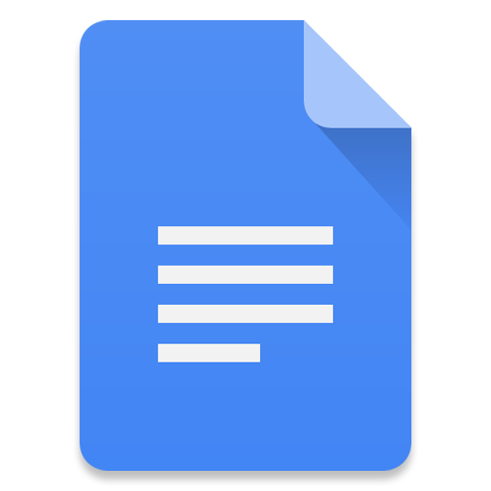
Collaboration tools
TRELLO
Create boards to organize tasks, making it easy to visualize and manage projects.
Share files, links, documents, and images
GOOGLE DOCS
Share and edit script and narration script.
Comment and feedback about the scripts
GOOGLE DRIVE
Store and create backup images, pictures and videos about the project.

Slide 12



Challenge faced
Coordination and
Communication:
Ensuring clear and consistent communication among team members can be difficult, especially with remote work or varying schedules.
Data Management:
Merging, cleaning, and preparing data from multiple sources can be time-consuming and complex.
Technical Limitations:
AI tools may have limitations that hinder the project, such as compatibility issues or lack of specific features.

Slide 13
How do we come up the solutions ?
Clear and consistent
communication:
Use project management tools (Trello) to keep everyone updated.
Schedule regular meetings to discuss progress and address issues promptly
Data Processing:
Use specialized data management tools (Google Drive) and establish standardized processes for handling data.
Regularly audit data processes to identify and address issues early
Technical Possibilities:
Stay updated with the latest AI advancements and explore alternative tools or methods.
Regularly review the toolset to ensure it meets project requirements,

Slide 14
Thank you for your attention

